Slide 1

Team B
Final Project

Slide 2
Customer Benefit
More efficient
Better customer experience
Better data
Keep track of orders, items, and returns
Produce data of to why people are returning their items
Data all kept in one place

Slide 3
Company Processes
Production Process:
This diagram contains the process model of how Deep Creek Outdoors manufactures fishing rods.
Production is an integral part of Deep Creek, so the goal of this model is to provide them with a visual that shows who does what and how all the pieces interact with one another.
Return Process:
This process is filled with all the elements that help to control how items are returned.
Returns were listed as a major problem in the companies documentation so with these elements documented and created we hope to alleviate that.
The returns process currently has no online portal for the customer at the clients request so it's all over the phone, or through mail but this can be adapted later.

Slide 4
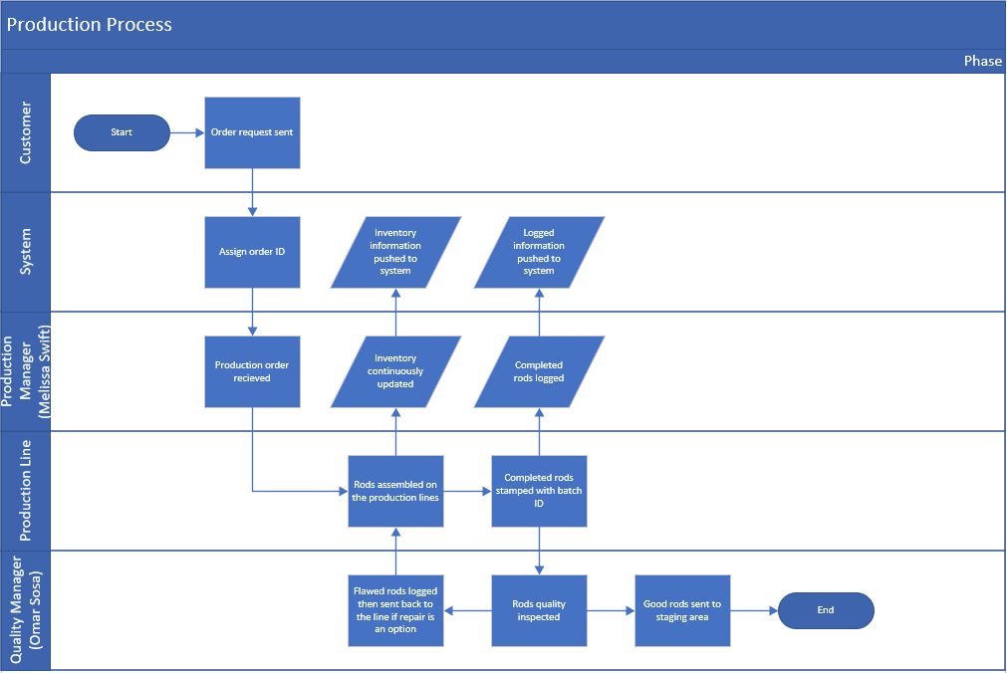
Production Process Pt.1
For the production process, there are five connection lanes:
Customer
System
Production Manager
Production Line
Quality Manager
These are the only roles that interact with the production of rods at the moment.

Slide 5
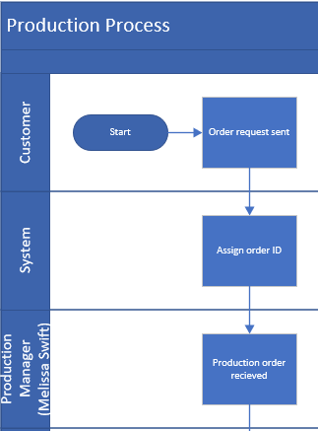
Production Process Pt.2
Production starts with a customer sending an order request and that order being put in the system.
When the order is put in the system, it is assigned an order ID.
Then, the order is sent to and received by the production manager, Melissa Swift.

Slide 6
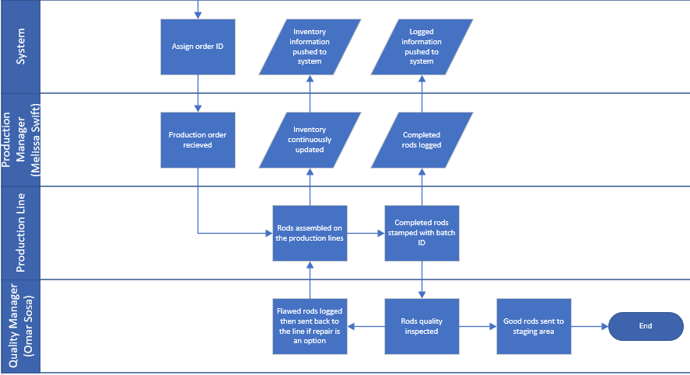
Production Process Pt.3
Once Melissa receives the production order, The production line begins work on the rods.
As inventory is being taken and turned into rods, Melissa pushes updates to the inventory system.
After rods are completed, they are stamped with the batch ID and logged in the system by Melissa.
They are then sent to the quality manager, Omar Sosa, to be inspected.
Lastly, Omar determines whether the rods are ready to be shipped or will send them back to the line to be repaired if defects are found.

Slide 7
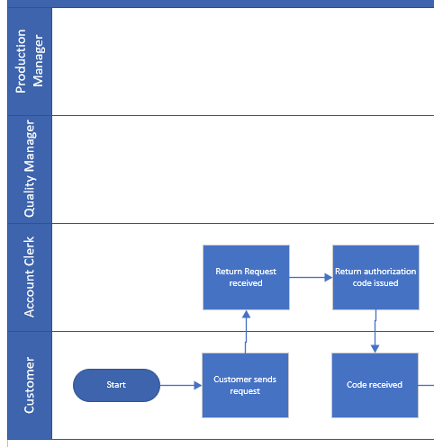
Return Process p.1
There are 4 connection lanes in the returns process:
Customer
Account Clerk
Quality Manager
Production Manager
These roles are the only people that currently deal with returns and touch the elements of the process.

Slide 8
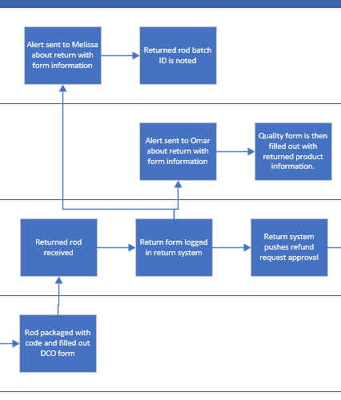
Return Process p.2
After the initial request from the customer is made the account clerk will review through the systems return page.
Then they will process the request and issue a return code so the customer can send the rod to the company.
After the rod has arrived it is then logged with the code that was given.
This is return notice notifies the quality manager who reviews and fills out the details of why it was returned.
An alert is also sent to the production manager about this return who notes which batch the returned rod was in.

Slide 9
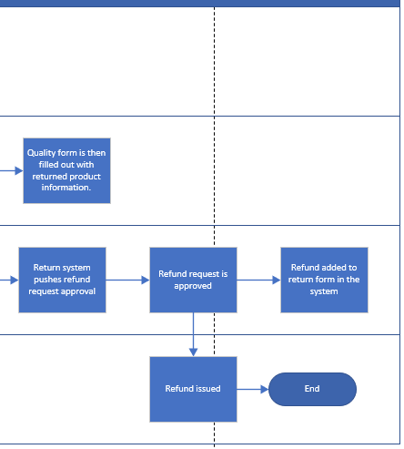
Return Process p.3
Finally after the initial return form is logged by the Account Clerk the system pushes a refund request to the Account Clerk through email.
This request is then dealt with outside of the system through the normal business accounting processes and then the refund is approved.
If the refund is approved then the account clerk notes the refund on the return form in the system and then issues the refund through the normal business accounting processes outside of the system.

Slide 10
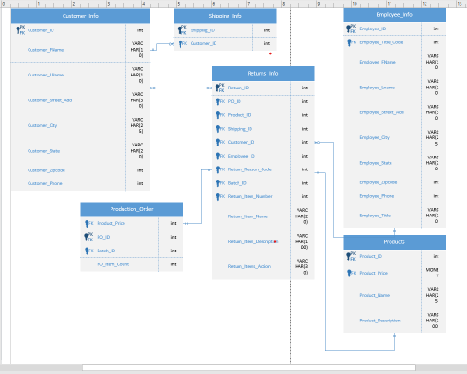
To-Be ERD

Slide 11
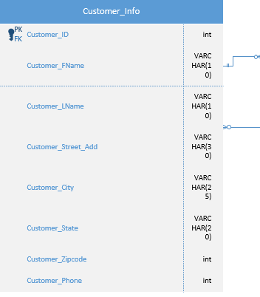
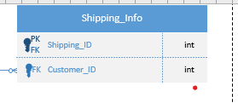
ERD connections
*Customer Info entity connects a primary key-one to many- to customer ID# in Shipping_info: This will link shipping to the customers Info

Slide 12
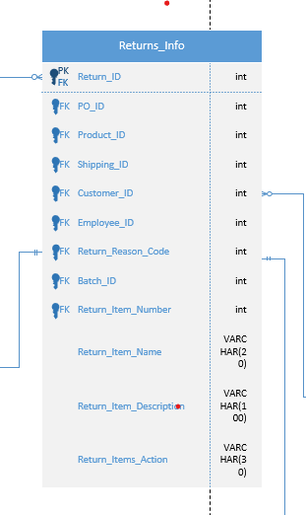
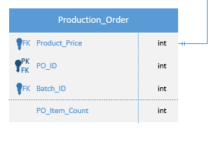
*ERD connections
*Production_Order entity connects-one to one- to primary key Return_Reason_Code from the Returns_Info entity: This will allow for the returns to be recorded with a code to keep track of why it was returned

Slide 13
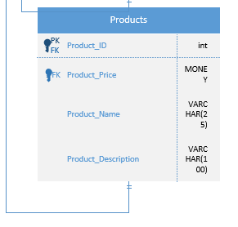
*ERD connections
*Products entity connects-one to one-to Returns_Info entity primary key Customer_ID: This will allow for the tracking of what product was returned from which customer.

Slide 14
ERD connections
*Products entity connects-one to one-to Returns_Info entity primary key Return_Reason_Code primary key: This will allow tracking of what product was returned with a return code for reason returned.

Slide 15
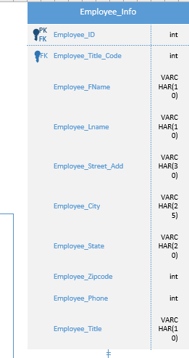
ERD connections
*Employee_Info entity is connected to Products entity and will allow the employees to look up products and connects to the rest of the database.

Slide 16


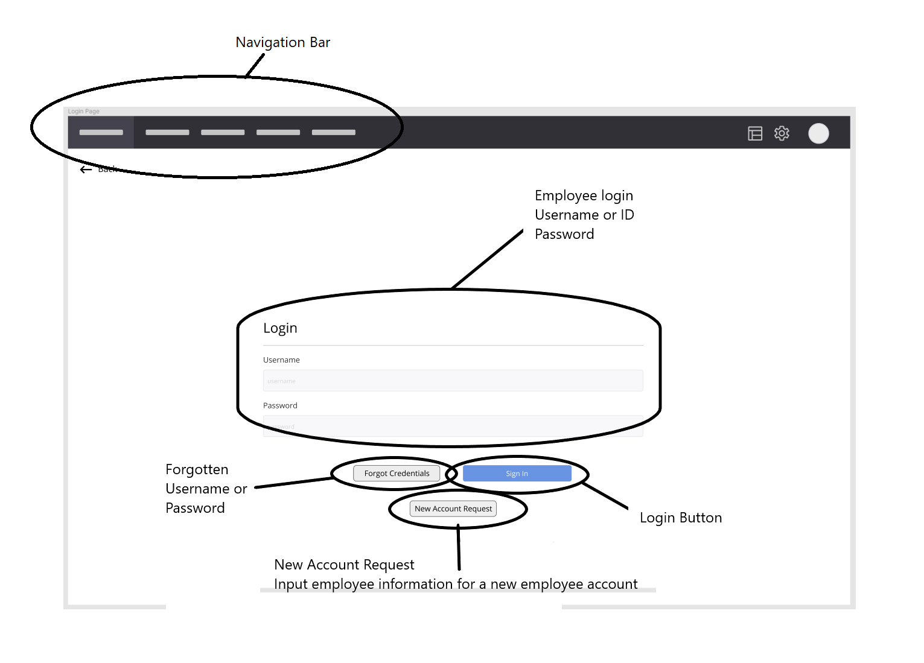
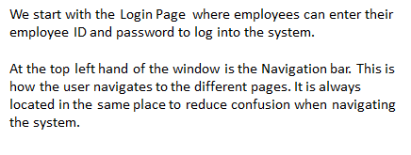
The login page has an entry field for the employee’s Login ID and their password. After entering their credentials, the employee would then click on the Sign In button. In the case of forgotten credentials, there is a button that would put in a request for support to help reset a password. There is also a New Account Request button that would input the employee information, such as name, SSN, and tax information for a new employee account.

Slide 17
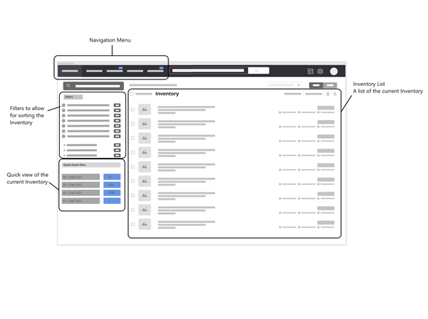


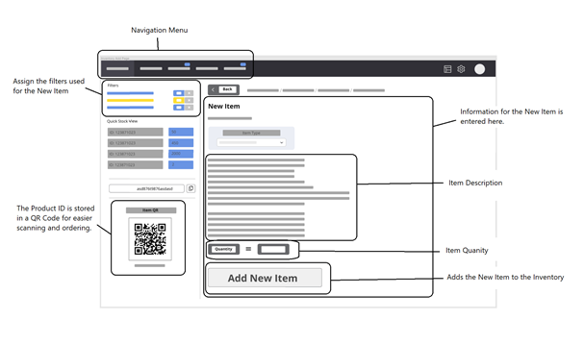
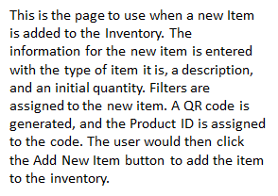

Slide 18
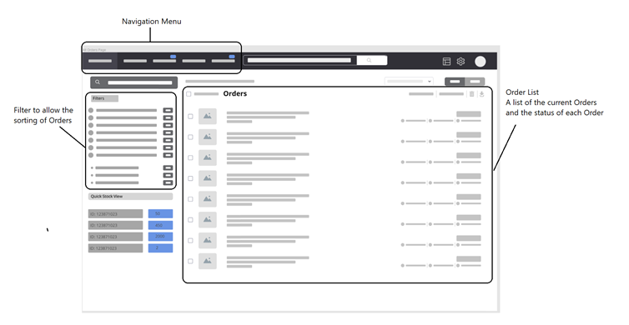

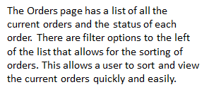
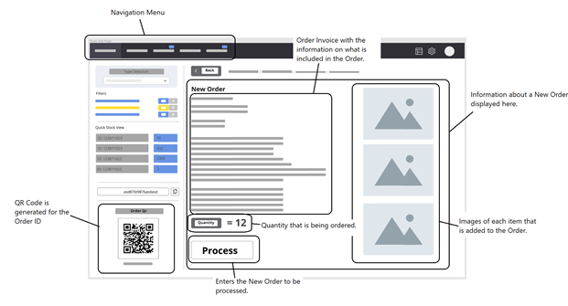
The New Order page is where a new order is processed. An invoice is listed for the order, as are images for each type of item that is included in the order. The quantity of the items in the order are displayed. A QR code is generated for the Order ID and assigned to the order when the Process button is clicked.

Slide 19
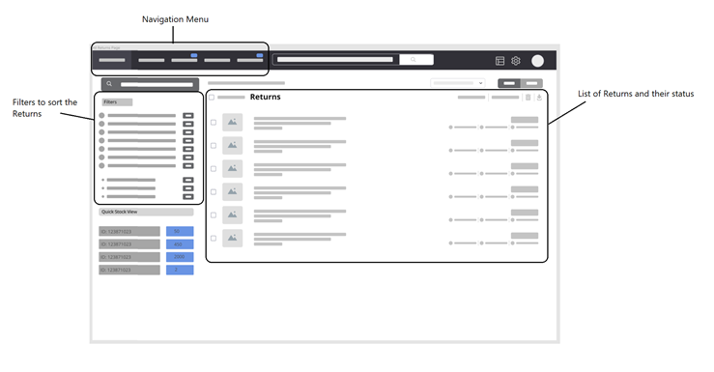

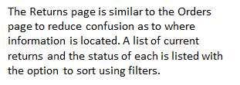
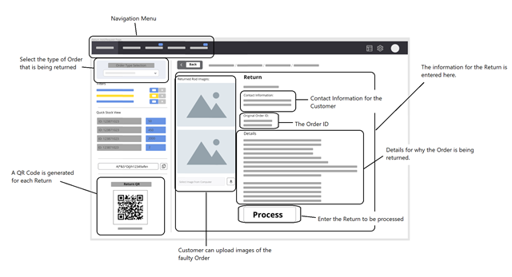
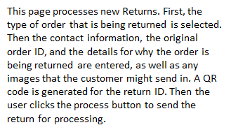

Slide 20
Thank You!
Have a great winter holiday!

